Slide 1
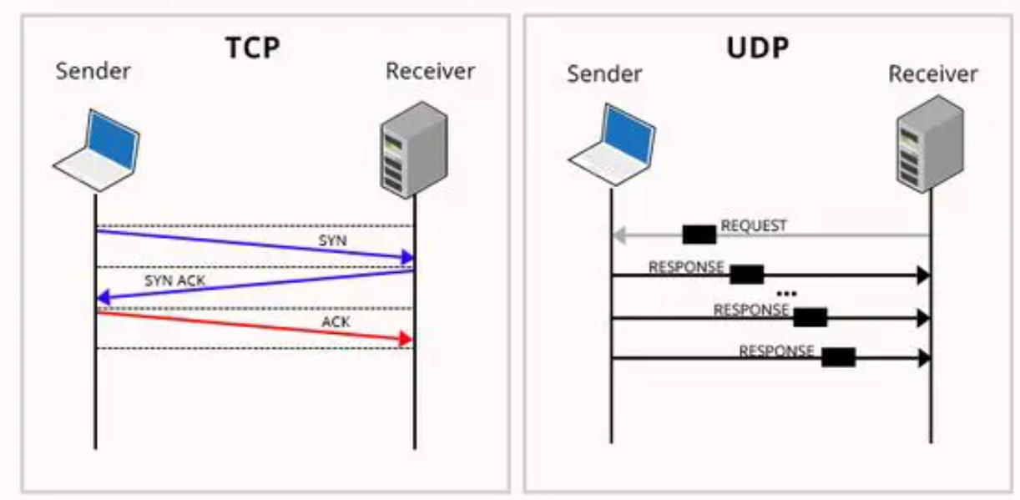
TRANSMISSION CONTROL PROTOCOL
Lecture by Hasan Shah
Book :Data Communication and Networks, Behrouz A. Forouzan 5e

Slide 2
Transmission Control Protocol (TCP)
TCP is a connection-oriented, reliable protocol.
TCP explicitly defines connection establishment, data transfer, and connection teardown phases to provide a connection-oriented service.
TCP uses a combination of GBN and SR protocols to provide reliability.
To achieve this goal, TCP uses checksum (for error detection), retransmission of lost or corrupted packets, cumulative and selective acknowledgments, and timers.

Slide 3
24.3.1 TCP Services
Before discussing TCP in detail, let us explain the services offered by TCP to the processes at the application layer.
Process-to-Process Communication
As with UDP, TCP provides process-to-process communication using port numbers.

Slide 4
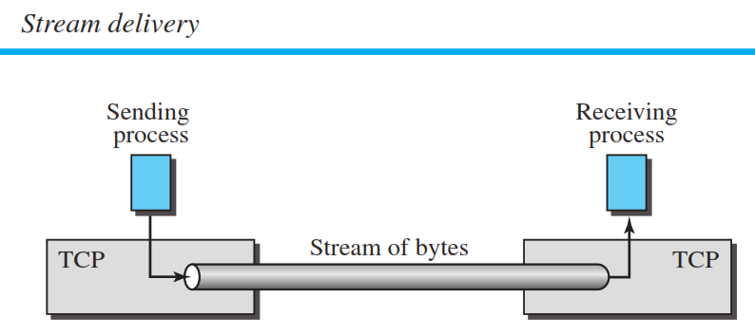
TCP Services Stream Delivery Service
TCP, unlike UDP, is a stream-oriented protocol.
In UDP, a process sends messages with predefined boundaries to UDP for delivery.
UDP adds its own header to each of these messages and delivers it to IP for transmission.
Each message from the process is called a user datagram, and becomes, eventually, one IP datagram.
Neither IP nor UDP recognizes any relationship between the datagrams.
TCP, on the other hand, allows the sending process to deliver data as a stream of bytes and allows the receiving process to obtain data as a stream of bytes.
TCP creates an environment in which the two processes seem to be connected by an imaginary “tube” that carries their bytes across the Internet.
This imaginary environment is depicted in Figure 24.4. The sending process produces (writes to) the stream and the receiving process consumes (reads from) it.

Slide 5
TCP Services Sending and Receiving Buffers
The sending and the receiving processes to write or read data at the same rate, needs buffers for storage.
There are two buffers, the sending buffer and the receiving buffer, one for each direction.
These buffers are necessary for flow- and error-control mechanisms used by TCP.
One way to implement a buffer is to use a circular array of 1-byte locations.
Two buffers of 20 bytes each; normally the buffers are hundreds or thousands of bytes, depending on the implementation. We also show the buffers as the same size, which is not always the case.

Slide 6
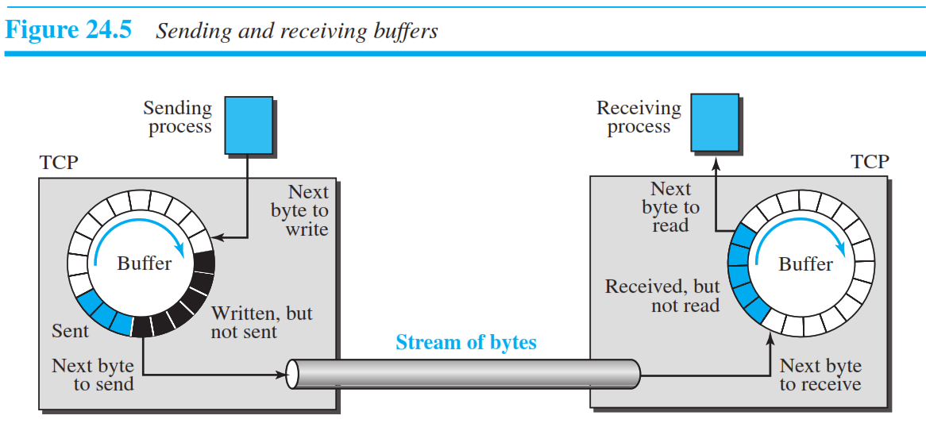
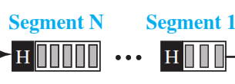
TCP Services Sending and Receiving Buffers
The figure shows the movement of the data in one direction.
At the sender, the buffer has three types of chambers.
The white section contains empty chambers that can be filled by the sending process (producer).
The Blue colored area holds bytes that have been sent but not yet acknowledged.
The TCP sender keeps these bytes in the buffer until it receives an acknowledgment.
The black shaded area contains bytes to be sent by the sending TCP.

Slide 7
TCP Services Sending and Receiving Buffers
TCP may be able to send only part of this Black shaded section due to the slowness of the receiving process or to congestion in the network.
Also note that, after the bytes in the Blue colored chambers are acknowledged, the chambers are recycled and available for use by the sending process.
This is why we show a circular buffer.
The operation of the buffer at the receiver is simpler.
The circular buffer is divided into two areas (shown as white and colored).
The white area contains empty chambers to be filled by bytes received from the network.

Slide 8
TCP Services Other Services
Full-Duplex Communication
TCP offers full-duplex service, where data can flow in both directions at the same time.
Each TCP endpoint then has its own sending and receiving buffer, and segments move in both directions.
Multiplexing and Demultiplexing
Like UDP, TCP performs multiplexing at the sender and demultiplexing at the receiver.
Connection-Oriented Service
TCP, unlike UDP, is a connection-oriented protocol.
When a process at site A wants to send to and receive data from another process at site B, the following three phases occur:
1. The two TCP’s establish a logical connection between them.
2. Data are exchanged in both directions.
3. The connection is terminated.
Note that this is a logical connection, not a physical connection.
Reliable Service
TCP is a reliable transport protocol. It uses an acknowledgment mechanism to check the safe and sound arrival of data. We will discuss this feature further in the section on error control

Slide 9
24.3.2 TCP Features
To provide the services mentioned in the previous section
TCP has several features.
Numbering System
Byte Number
Sequence Number
Segment (not included)
Encapsulation

Slide 10
TCP Features Numbering System
Although the TCP software keeps track of the segments being transmitted or received.
There is no field for a segment number value in the segment header.
Instead, there are two fields,
sequence number
the acknowledgment number.
These two fields refer to a byte number and not a segment number.

Slide 11
Numbering System Byte Number
TCP numbers all data bytes (octets) that are transmitted in a connection.
Numbering is independent in each direction.
When TCP receives bytes of data from a process, TCP stores them in the sending buffer and numbers them.
The numbering does not necessarily start from 0.
Instead, TCP chooses an arbitrary number between 0 and 2³² − 1 for the number of the first byte.
For example, if the number happens to be 1057 and the total data to be sent is 6000 bytes, the bytes are numbered from 1057 to 7056.
Byte numbering is used for flow and error control.

Slide 12
Numbering System Sequence Number
Once numbered, TCP assigns a sequence number to each segment that is being sent.
The sequence number, in each direction, is defined as follows:
1. The sequence number of the first segment is the ISN (initial sequence number), which is a random number.
2. The sequence number of any other segment is the sequence number of the previous segment plus the number of bytes (real or imaginary) carried by the previous segment.
When a segment carries a combination of data and control information (piggybacking), it uses a sequence number.
If a segment does not carry user data, it does not logically define a sequence number. The field is there, but the value is not valid.
However, segments, when carrying only control information, need a sequence number to allow an acknowledgment from the receiver.
These segments are used for connection establishment, termination, or abortion.
Each of these segments consume one sequence number as though it carries one byte, but there are no actual data. We will elaborate on this issue when we discuss connections.

Slide 13
Numbering System Acknowledgment Number
As communication in TCP is full duplex
when a connection is established, both parties can send and receive data at the same time.
Each party numbers the bytes, usually with a different starting byte number.
The sequence number in each direction shows the number of the first byte carried by the segment.
Each party also uses an acknowledgment number to confirm the bytes it has received.
However, the acknowledgment number defines the number of the next byte that the party expects to receive.
The acknowledgment is cumulative, meaning that the party takes the number of the last byte that it has received, safe and sound, adds 1 to it, and announces this sum as the acknowledgment number.

Slide 14
TCP Features Encapsulation
A TCP segment encapsulates the data received from the application layer. The TCP segment is encapsulated in an IP datagram, which in turn is encapsulated in a frame at the data-link layer.

Slide 15
24.3.4 A TCP Connection (TCP is connection-oriented)
A connection-oriented transport protocol establishes a logical path between the source and destination.
A single logical pathway facilitates the acknowledgment process as well as retransmission of damaged or lost frames.
You may wonder how TCP, which uses the services of IP, a connectionless protocol, can be connection-oriented.
The point is that a TCP connection is logical, not physical.
TCP operates at a higher level.
TCP uses the services of IP to deliver individual segments to the receiver, but it controls the connection itself.
If a segment is lost or corrupted, it is retransmitted.
Unlike TCP, IP is unaware of this retransmission.
If a segment arrives out of order, TCP holds it until the missing segments arrive; IP is unaware of this reordering.
In TCP, connection-oriented transmission requires three phases:
connection establishment, data transfer, and connection termination

Slide 16
A TCP Connection Connection Establishment
TCP transmits data in full-duplex mode.
When two TCPs in two machines are connected, they are able to send segments to each other simultaneously.
This implies that each party must initialize communication and get approval from the other party before any data are transferred.

Slide 17
A TCP Connection Connection Establishment Three-Way Handshaking
The connection establishment in TCP is called three-way handshaking.
For example,
an application program, called the client, wants to make a connection with another application program, called the server, using TCP as the transport-layer protocol.
The process starts with the server.
The server program tells its TCP that it is ready to accept a connection.
This request is called a passive open.
Although the server TCP is ready to accept a connection from any machine in the world, it cannot make the connection itself.
The client program issues a request for an active open.
A client that wishes to connect to an open server tells its TCP to connect to a particular server.
TCP can now start the three-way handshaking process.

Slide 18
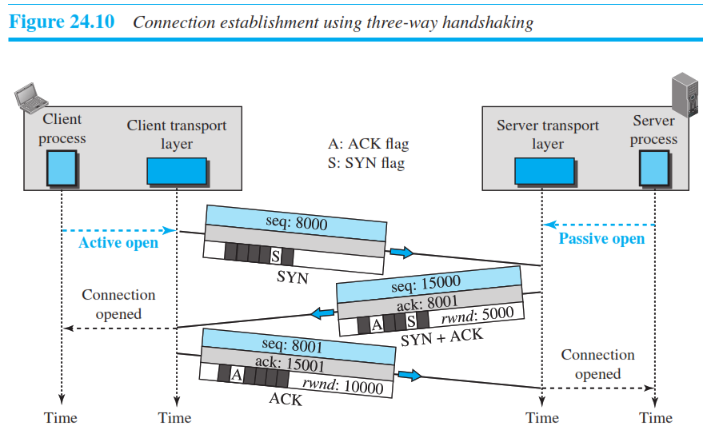
Three-way handshaking process
To show the process we use time lines.
Each segment has values for all its header fields and perhaps for some of its option fields too.
However, we show only the few fields necessary to understand each phase.
We show the
sequence number,
the acknowledgment number,
the control flags (only those that are set), and
window size if relevant.
The three steps in this phase are explained next

Slide 19
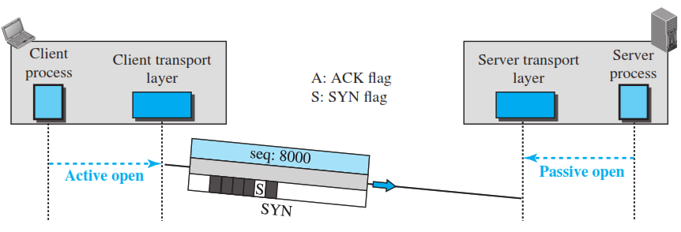
Step 1 Connection
The client sends the first segment, a SYN segment, in which only the SYN flag is set.
This segment is for synchronization of sequence numbers.
The client, chooses a random number as the first sequence number and sends this number to the server.
This sequence number is called the initial sequence number (ISN).
Note that this segment does not contain an acknowledgment number.
It does not define the window size either; a window size definition makes sense only when a segment includes an acknowledgment.
Note that the SYN segment is a control segment and carries no data.
However, it consumes one sequence number because it needs to be acknowledged.
We can say that the SYN segment carries one imaginary byte.

Slide 20
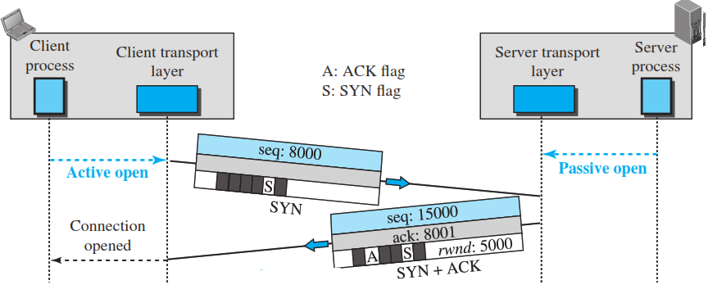
Step 2 Connection
The server sends the second segment, a SYN + ACK segment with two flag bits set as: SYN and ACK.
This segment has a dual purpose.
First, it is a SYN segment for communication in the other direction.
The server uses this segment to initialize a sequence number for numbering the bytes sent from the server to the client.
The server also acknowledges the receipt of the SYN segment from the client by setting the ACK flag and displaying the next sequence number it expects to receive from the client.
Because the segment contains an acknowledgment, it also needs to define the receive window size, rwnd (to be used by the client).
which means that the maximum size of the window is 65,535 bytes. This value is normally referred to as the receiving window (rwnd) and is determined by the receiver. The sender must obey the dictation of the receiver in this case.
Since this segment is playing the role of a SYN segment, it needs to be acknowledged. It, therefore, consumes one sequence number.

Slide 21
Step 3 Connection
The client sends the third segment.
This is just an ACK segment. It acknowledges the receipt of the second segment with the ACK flag and acknowledgment number field.
Note that the ACK segment does not consume any sequence numbers if it does not carry data, but some implementations allow this third segment in the connection phase to carry the first chunk of data from the client.
In this case, the segment consumes as many sequence numbers as the number of data bytes.

Slide 22
A TCP Connection Connection Establishment SYN Flooding Attack
TCP is susceptible to a serious security problem called SYN flooding attack.
When one or more malicious attackers send a large number of SYN segments to a server pretending that each of them is coming from a different client by faking the source IP addresses in the datagrams.
The server, assuming that the clients are issuing an active open, allocates the necessary resources, such as creating transfer control block (TCB) tables and setting timers.
The TCP server then sends the SYN + ACK segments to the fake clients, which are lost.
When the server waits for the third leg of the handshaking process, however, resources are allocated without being used.
If, during this short period of time, the number of SYN segments is large, the server eventually runs out of resources and may be unable to accept connection requests from valid clients.
This SYN flooding attack belongs to a group of security attacks known as a denial of service attack (DOS), in which an attacker monopolizes a system with so many service requests that the system overloads and denies service to valid requests.
Some implementations of TCP have strategies to alleviate the effect of a SYN attack.
Some have imposed a limit of connection requests during a specified period of time.
Others try to filter out datagrams coming from unwanted source addresses.
One recent strategy is to postpone resource allocation until the server can verify that the connection request is coming from a valid IP address, by using what is called a cookie.
SCTP, the new transport-layer protocol that we discuss later, uses this strategy

Slide 23
A TCP Connection Data Transfer
After connection is established, bidirectional data transfer can take place.
The client and server can send data and acknowledgments in both directions.
It is enough to know that data traveling in the same direction as an acknowledgment are carried on the same segment. The acknowledgment is piggybacked with the data.

Slide 24
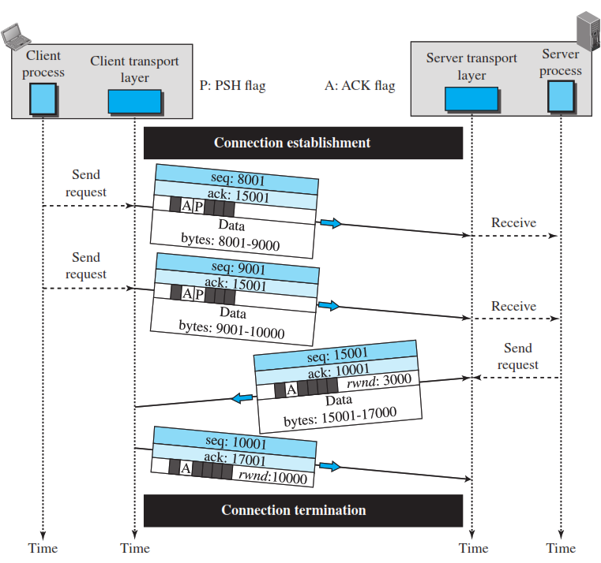
Data Transfer Example
Figure 24.11 shows an example.
In this example, after a connection is established, the client sends 2,000 bytes of data in two segments. (8000 – 9000) + (9000 – 10000)
The server then sends 2,000 bytes in one segment. The client sends one more segment. (15000-17000)
The first three segments carry both data and acknowledgment, but the last segment carries only an acknowledgment because there is no more data to be sent.
Note the values of the sequence and acknowledgment numbers.
The data segments sent by the client have the PSH (P) (push) flag set so that the server TCP knows to deliver data to the server process as soon as they are received.
The segment from the server, on the other hand, does not set the push flag.
Most TCP implementations have the option to set or not to set this flag

Slide 25
Data Transfer Pushing Data
We saw that the sending TCP uses a buffer to store the stream of data coming from the sending application program.
The sending TCP can select the segment size.
The receiving TCP also buffers the data when they arrive and delivers them to the application program when the application program is ready or when it is convenient for the receiving TCP.
This type of flexibility increases the efficiency of TCP.
However, there are occasions in which the application program has no need for this flexibility.
For example, consider an application program that communicates interactively with another application program on the other end.
The application program on one site wants to send a chunk of data to the application program at the other site and receive an immediate response.
Delayed transmission and delayed delivery of data may not be acceptable by the application program

Slide 26
Data Transfer Pushing Data(Conti….)
TCP can handle such a situation.
The application program at the sender can request a push operation.
This means that the sending TCP must not wait for the window to be filled.
It must create a segment and send it immediately.
The sending TCP must also set the push bit (PSH) to let the receiving TCP know that the segment includes data that must be delivered to the receiving application program as soon as possible and not to wait for more data to come.
This means to change the byte oriented TCP to a chunk-oriented TCP, but TCP can choose whether or not to use this feature

Slide 27
A TCP Connection Connection Termination
Either of the two parties involved in exchanging data (client or server) can close the connection, although it is usually initiated by the client.
Most implementations today allow two options for connection termination:
Three-way handshaking and
Four-way handshaking with a half-close option.

Slide 28
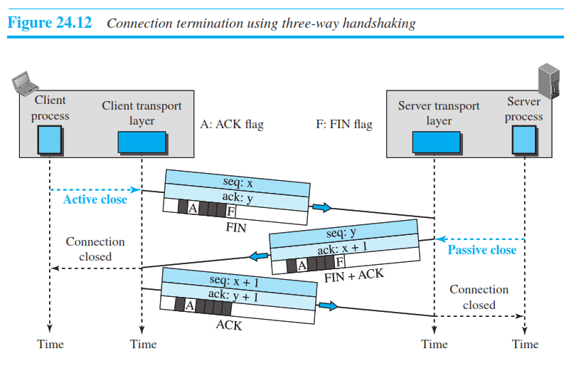
Connection Termination Three-Way Handshaking
Most implementations today allow three-way handshaking for connection termination, as shown in Figure 24.12.

Slide 29
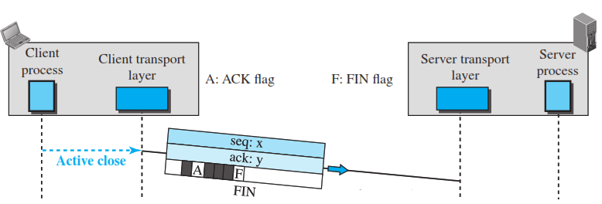
Step 1 Connection Termination
In this situation, the client TCP, after receiving a close command from the client process, sends the first segment, a FIN segment in which the FIN flag is set.
Note that a FIN segment can include the last chunk of data sent by the client or it can be just a control segment as shown in the figure.
If it is only a control segment, it consumes only one sequence number because it needs to be acknowledged.

Slide 30
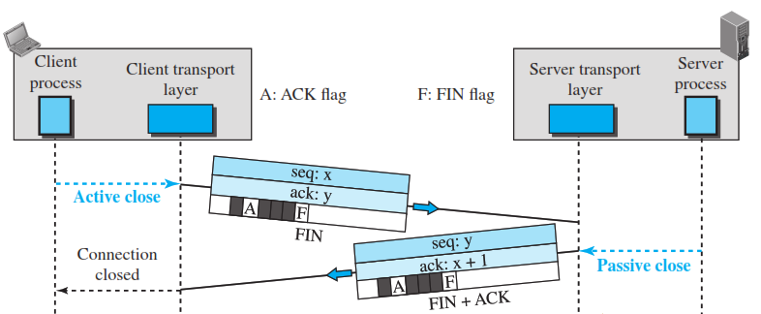
Step 2 Connection Termination
The server TCP, after receiving the FIN segment, informs its process of the situation and sends the second segment, a FIN + ACK segment, to confirm the receipt of the FIN segment from the client and at the same time to announce the closing of the con- nection in the other direction.
This segment can also contain the last chunk of data from the server.
If it does not carry data, it consumes only one sequence number because it needs to be acknowledged.

Slide 31
Step 3 Connection Termination
The client TCP sends the last segment, an ACK segment, to confirm the receipt of the FIN segment from the TCP server.
This segment contains the acknowledgment number, which is one plus the sequence number received in the FIN segment from the server.
This segment cannot carry data and consumes no sequence numbers.

Slide 32
Connection Termination Four-way Handshaking Half-Close
In TCP, one end can stop sending data while still receiving data.
This is called a halfclose.
Either the server or the client can issue a half-close request.
It can occur when the server needs all the data before processing can begin.
A good example is sorting.
When the client sends data to the server to be sorted, the server needs to receive all the data before sorting can start.
This means the client, after sending all data, can close the connection in the client-to-server direction.
However, the server-to-client direction must remain open to return the sorted data.

Slide 33
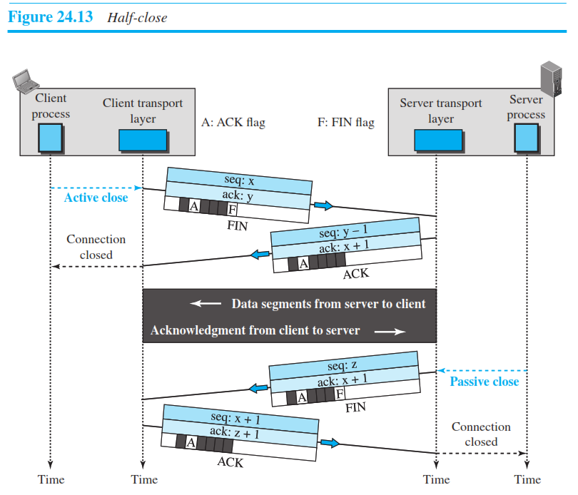
Connection Termination Four-way Handshaking Half-Close
The server, after receiving the data, still needs time for sorting; its outbound direction must remain open.
Figure 24.13 shows an example of a half-close.
The data transfer from the client to the server stops.
The client half-closes the connection by sending a FIN segment.
The server accepts the half-close by sending the ACK segment.
The server, however, can still send data. When the server has sent all of the processed data, it sends a FIN segment, which is acknowledged by an ACK from the client.
After half-closing the connection, data can travel from the server to the client and acknowledgments can travel from the client to the server.
The client cannot send any more data to the server.

Slide 34
A TCP Connection Connection Reset
TCP at one end may deny a connection request, may abort an existing connection, or may terminate an idle connection.
All of these are done with the RST (reset) flag.

Slide 35
24.3.7 Flow Control
As discussed before, flow control balances the rate a producer creates data with the rate a consumer can use the data.
TCP separates flow control from error control.
In this section we discuss flow control, ignoring error control.
We assume that the logical channel between the sending and receiving TCP is error-free

Slide 36
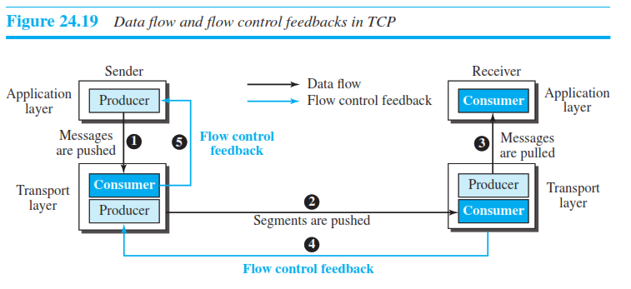
Flow Control
Figure 24.19 shows unidirectional data transfer between a sender and a receiver; bidirectional data transfer can be deduced from the unidirectional process.
The figure shows that data travel from the sending process down to the sending TCP, from the sending TCP to the receiving TCP, and from the receiving TCP up to the receiving process (paths 1, 2, and 3).
Flow control feedbacks, are traveling from the receiving TCP to the sending TCP and from the sending TCP up to the sending process (paths 4 and 5).
Flow control feedback from the sending TCP to the sending process (path 5) is achieved through simple rejection of data by the sending TCP when its window is full.
This means that our discussion of flow control concentrates on the feedback sent from the receiving TCP to the sending TCP (path 4).

Slide 37
Silly Window Syndrome
A serious problem can arise in the sliding window operation when either the sending application program creates data slowly or the receiving application program consumes data slowly, or both.
Any of these situations results in the sending of data in very small segments, which reduces the efficiency of the operation.
For example, if TCP sends segments containing only 1 byte of data, it means that a 41-byte datagram (20 bytes of TCP header and 20 bytes of IP header) transfers only 1 byte of user data. Here the overhead is 41/1, which indicates that we are using the capacity of the network very inefficiently.
The inefficiency is even worse after accounting for the data-link layer and physical-layer overhead.
This problem is called the silly window syndrome.

Slide 38
Problem and Solution to silly window
For each site, we first describe how the problem is created and then give a proposed solution.
The sending TCP may create a silly window syndrome if it is serving an application program that creates data slowly,
For example, 1 byte at a time.
The application program writes 1 byte at a time into the buffer of the sending TCP.
The result is a lot of 41-byte segments that are traveling through an internet.
The solution is to prevent the sending TCP from sending the data byte by byte.
The sending TCP must be forced to wait and collect data to send in a larger block.
How long should the sending TCP wait?
If it waits too long, it may delay the process. If it does not wait long enough, it may end up sending small segments.

Slide 39
Solution for Sender side
Nagle found an elegant solution.
The sending TCP sends the first piece of data it receives from the sending application program even if it is only 1 byte.
Step 2 : After sending the first segment, the sending TCP accumulates data in the output buffer and waits until either the receiving TCP sends an acknowledgment or until enough data have accumulated to fill a maximum-size segment.
At this time, the sending TCP can send the segment.
Step 2 is repeated for the rest of the transmission.
The elegance of Nagle’s algorithm is in its simplicity and in the fact that it takes into account the speed of the application program that creates the data and the speed of the network that transports the data.
If the application program is faster than the network, the segments are larger (maximum-size segments).
If the application program is slower than the network, the segments are smaller (less than the maximum segment size).

Slide 40
Syndrome Created by the Receiver
The receiving TCP may create a silly window syndrome if it is serving an application program that consumes data slowly
For example, 1 byte at a time.
Suppose that the sending application program creates data in blocks of 1 kilobyte, but the receiving application program consumes data 1 byte at a time.
Also suppose that the input buffer of the receiving TCP is 4 kilobytes.
The sender sends the first 4 kilobytes of data.
The receiver stores it in its buffer. Now its buffer is full.
It advertises a window size of zero, which means the sender should stop sending data.
The receiving application reads the first byte of data from the input buffer of the receiving TCP.
Now there is 1 byte of space in the incoming buffer.
The receiving TCP announces a window size of 1 byte, which means that the sending TCP, which is eagerly waiting to send data, takes this advertisement as good news and sends a segment carrying only 1 byte of data.
The procedure will continue. One byte of data is consumed and a segment carrying 1 byte of data is sent.
Again, we have an efficiency problem and the silly window syndrome.

Slide 41
Solution to Receiver silly window
Two solutions have been proposed to prevent the silly window syndrome created by an application program that consumes data more slowly than they arrive.
Clark’s solution is to send an acknowledgment as soon as the data arrive, but to announce a window size of zero until either there is enough space to accommodate a segment of maximum size or until at least half of the receive buffer is empty.
The second solution is to delay sending the acknowledgment.
This means that when a segment arrives, it is not acknowledged immediately.
The receiver waits until there is a decent amount of space in its incoming buffer before acknowledging the arrived segments.
The delayed acknowledgment prevents the sending TCP from sliding its window.
After the sending TCP has sent the data in the window, it stops. This kills the syndrome.
Delayed acknowledgment also has another advantage:
it reduces traffic.
The receiver does not have to acknowledge each segment.
There also is a disadvantage in that the delayed acknowledgment may result in the sender unnecessarily retransmitting the unacknowledged segments.

Slide 42
24.3.9 Congestion Control

